Slide 1

UNIVERSITY INSTITUTE OF ENGINEERING
COMPUTER SCIENCE ENGINEERING
Bachelor of Engineering (Computer Science & Engineering)
Subject Name: Block chain Technology
Subject Code: 20_CST-412
Supply Chain
CO2
Prepared By:
Er. Ankita Sharma
DISCOVER . LEARN . EMPOWER

Slide 2
Various uses of Block chain
Government,
Healthcare,
Medical Research,
Supply chain,
Copyright,
Fine art

Slide 3
What is the supply chain?
Practically every product that reaches an end-user represents the cumulative effort of many organizations and stakeholders. These are referred to collectively as the supply chain.
Organizations within a supply chain are linked through physical and information flows:
Physical flows involve the transformation, movement, and storage of goods and materials
Information flows involve the coordination between partners to control the day-to-day flow of goods and materials up and down the supply chain; it also involves long-term planning.

Slide 4
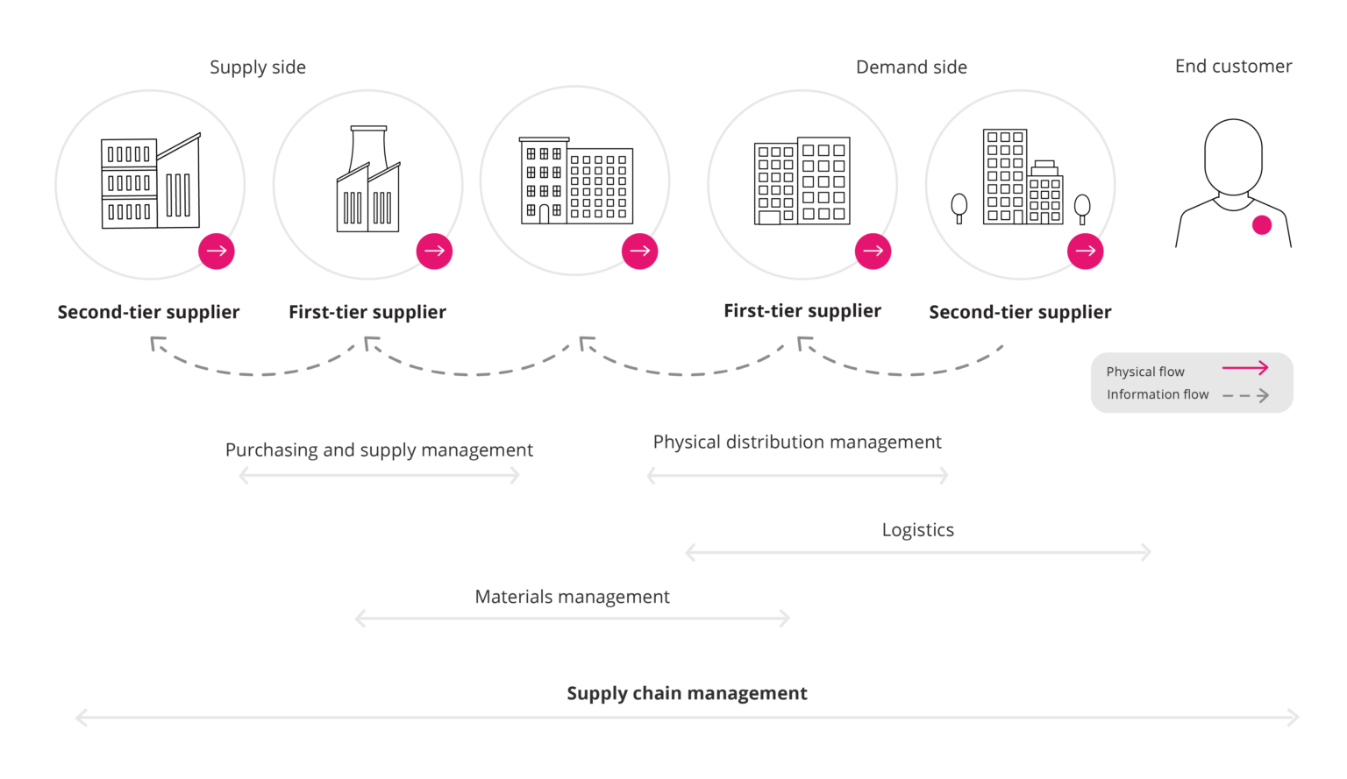

Slide 5
Supply chain challenges
Visibility: Accurately identifying and collecting data from all links in the supply chain
Disclosure: Communicating this information, internally and externally, at the appropriate level of detail
Inefficiencies in systems –
For example, where vendors and suppliers try in vain to connect the dots on who needs what, when, and how – are another common challenge.
A few more examples of inefficiencies are bad upstream inventory management, poor allocation of products to stores, fluctuating demand, and even slow shelf rotation.
Product recalls are expensive and inconvenient, with companies needing to trace products and suppliers back to their origin to address issues.

Slide 6
Block chain Solutions
Automotive Supplier Payments
Blockchain allows the transfer of funds anywhere in the world without the need for traditional banking transactions, as transactions are made directly between payer and payee. It is also secure and rapid; taking minutes, compared to days for automated clearing house payments, for example.
Bitcoin transfers specifically also incur lower fees. Australian vehicle manufacturer Tomcar uses Bitcoin to pay some of its suppliers. Currently, three partners in Israel and Taiwan accept payment from Tomcar using Bitcoin.

Slide 7
Enhance Traceability
Companies can use distributed ledger systems (blockchains) to record product status at each stage of production. The records are permanent and immutable. They make it possible to trace each product to its source. Global retailer Walmart uses blockchain to track sales of pork in China. Its system lets the company see where each piece of meat comes from, each processing and storage step in the supply chain, and the products’ sell-by date. In the event of a product recall, the company can also see which batches are affected and who bought them.

Slide 8
Cold Chain Monitoring
Food and pharmaceutical products often have specialised storage needs. Moreover, enterprises see the value in sharing warehouses and distribution centres instead of each one paying for its own. Sensors on sensitive products can record temperature, humidity, vibration, and other environmental conditions.
These readings can then be stored on a blockchain. They are permanent and tamper-proof. If a storage condition deviates from what is agreed, each member of the blockchain will see it. A smart contract can trigger a response to correct the situation. For instance, depending on the size of the deviation, the action may be to adjust the storage. However, it could also extend to changing “use-by” dates, declaring products unfit, or applying penalties.

